Slide 1
Modules

Slide 2
Objectives
This chapter introduces
Introduction to a module
Design and import modules
Removal of ambiguity

Slide 3
Modules
As your program gets longer, you may want to split it into several files for easier maintenance
You may also want to use a handy function that you’ve written in several programs without copying its definition into each program
Python has a way to put definitions in a file and use them in a script or in an interactive instance of the interpreter.
Such a file is called a module

Slide 4
Modules
A module is a file containing Python definitions and statements
Definitions from a module can be imported into other modules or into the main module
The file name is the module name with the suffix .py appended
Within a module, the module’s name (as a string) is available as the value of the global variable __name__

Slide 5
Example
# fibo.py
# Fibonacci numbers module
def fib(n): # write Fibonacci series up to n
a, b = 0, 1
while a < n:
print(a, end=' ')
a, b = b, a+b
print()
def fib2(n): # return Fibonacci series up to n
result = []
a, b = 0, 1
while a < n:
result.append(a)
a, b = b, a+b
return result
# main.py
import fibo
fibo.fib(500)
print(fibo.fib2(500))

Slide 6
Modules
A module can contain executable statements as well as function definitions
These statements are intended to initialize the module
They are executed only the first time the module name is encountered in an import statement

Slide 7
Import Statement
There is a variant of the import statement that imports names from a module directly into the importing module’s namespace
There is even a variant to import all names that a module defines
# main.py
from fibo import fib, fib2
fib(500)
print(fib2(500))
# main.py
from fibo import *
fib(500)
print(fib2(500))

Slide 8
Import Statement
If the module name is followed by as, then the name following as is bound directly to the imported module
It can also be used when utilizing from with similar effects
# main.py
import fibo as fib
fib.fib(500)
print(fib.fib2(500))
# main.py
from fibo import fib as fibonacci
fibonacci(500)

Slide 9
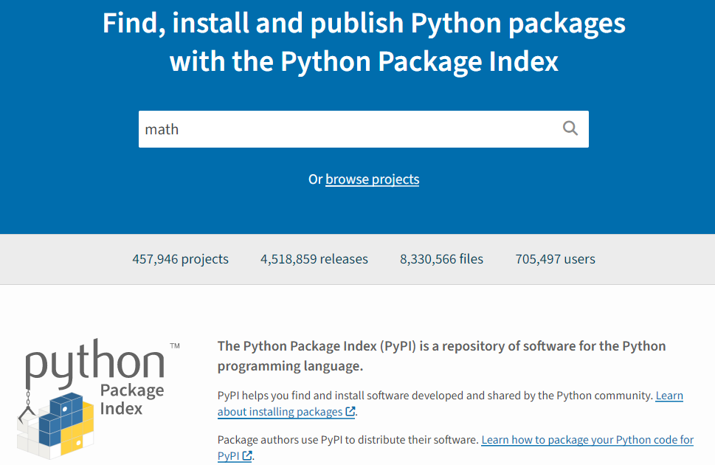
Python Package Index
The Python Package Index (PyPI) is a repository of software for the Python programming language
You can find, install, and publish Python packages with the Python Package Index
Website: https://pypi.python.org/pypi

Slide 10
Packages
Packages are a way of structuring Python’s module namespace by using “dotted module names”
The module name A.B designates a submodule named B in a package named A
Suppose you want to design a collection of modules (a “package”) for mathematical data, you can create your package expressed in terms of a hierarchical filesystem

Slide 11
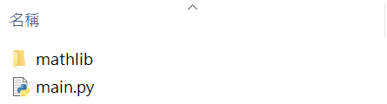
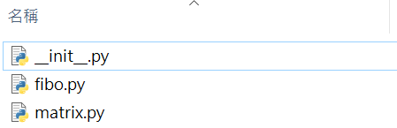
Example of a Package
To create a package named mathlib with modules fibo and matrix
Create a folder named mathlib
Add fibo.py and matrix.py in the mathlib folder
Create an empty file named __init__.py
The __init__.py files are required to make Python treat directories containing the file as packages

Slide 12
How to Call a Function of Modules defined in a Package
# main.py
from mathlib import fibo, matrix
fibo.fib(500)
print(fibo.fib2(500))
# main.py
from mathlib.fibo import *
fib(500)
print(fib2(500))

Slide 13
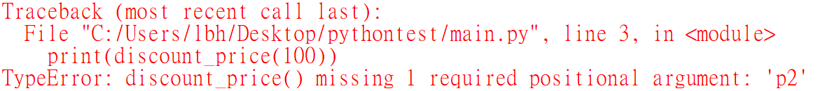
Import Two Modules with Same Function Name
When you import all functions from two modules that have the same function names, the latest one will be considered by the interpreter
#mod_1.py
def discount_price(p):
return p * 0.8
#mod_2.py
def discount_price(p1, p2):
return (p1 + p2) * 0.75
#main.py
from mod_1 import *
from mod_2 import *
print(discount_price(100))

Slide 14
Removal of Ambiguity
Import two modules that have different names and call your preferred function via the module name to avoid ambiguity
#mod_1.py
def discount_price(p):
return p * 0.8
#mod_2.py
def discount_price(p1, p2):
return (p1 + p2) * 0.75
#main.py
import mod_1
import mod_2
print(mod_1.discount_price(100)) print(mod_2.discount_price(100, 200))

Slide 15
Removal of Ambiguity
Import two modules by using as to indicate two different module names
#mod_1.py
def discount_price(p):
return p * 0.8
#mod_2.py
def discount_price(p1, p2):
return (p1 + p2) * 0.75
#main.py
import mod_1 as m1
import mod_2 as m2
print(m1.discount_price(100))
print(m2.discount_price((100, 200)))

Slide 16
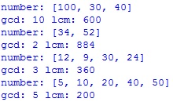
Exercise 1
Design a module that contains two functions gcd(L) and lcm(L), where L is a list with numbers, and gcd(L) and lcm(L) can be used to get the greatest common divisor and the least common multiple, respectively, of the given numbers in L
Please input a list of numbers from each line of the file input.txt and use the defined functions to output the corresponding gcd and lcm on your screen
Input.txt
Output
100 30 40
34 52
12 9 30 24
5 10 20 40 50

Slide 17
Source
References:
https://pypi.python.org/pypi
https://docs.python.org/3/tutorial/modules.html
https://datascienceplus.com/how-to-import-two-modules-with-same-function-name-in-python/

